Slide 1
Rapid Parallel Location Mapping
Jasper Toscani Field

Slide 2
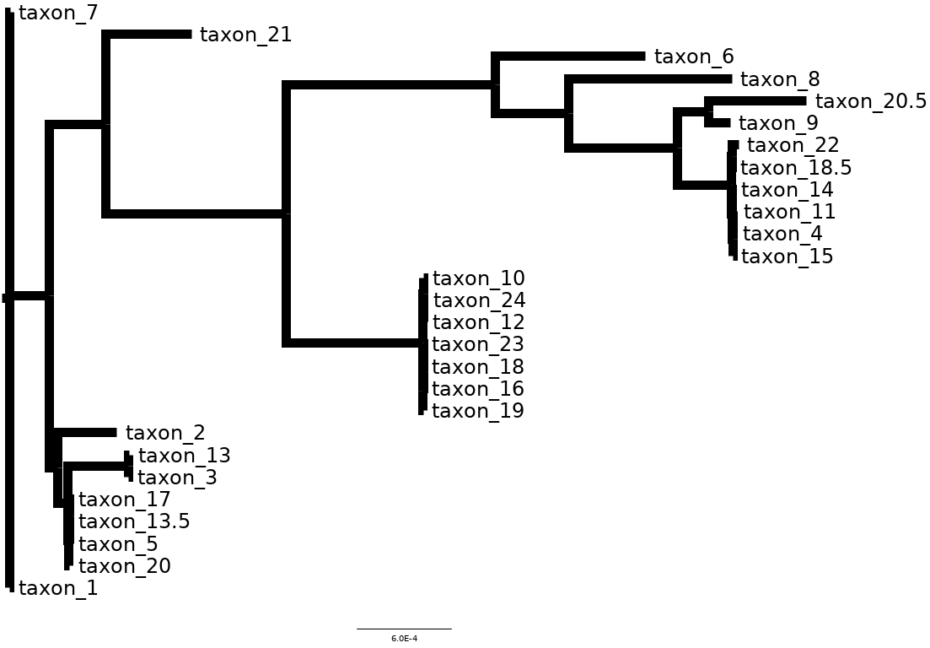
Biologists care about relationships
Evolutionary relationships are important for all fields of biology
Tracking disease transmission
Protecting endangered species
Many others
Phylogenetic trees show organism evolutionary relationships

Slide 3
Examining sequence similarity provides information on relationships
Homology
- Similarity of DNA sequences, possibly from shared evolutionary orgins
Sp. C Sp. B Sp. A
>Species A: AAGCTTGA
>Species B: ACGCTCGA
>Species C: ACGCTCGA

Slide 4
Can we identify the most similar sequence before any analysis?
We want to collect two types of data from one data processing run:
Identify the most similar sequence (species)
Collect sequence data location/variation information
Species A: AAGCTTGA
Species B: ACGCTAGA
Species C: ACGCTCGA
New Data
Sp A
Sp. B
Sp. C

Slide 5
Sequencing genomes produces reads, short strings of sequences.
Sequence read
Sequence read
Sequence read
Sequence read
Sequence read
Sequence read
Sequence read
Sequence read
Sequence read
Sequence read
Sequence read
Sequence read
Sequence read
Sequence read
Sequence read
Sequence read
Genome
ACGTAA........................................................................................................................ACGT

Slide 6
Genomes are often used to make Multiple Sequence Alignments (MSA)
MSAs align DNA we think are similar (potentially homologuous).
Genes 1, 2 and 3 included for all species in the alignment
Gene 1
Gene 2
Gene 3
Species A
Species B
New Species

Slide 7
Typical genomic workflow
1 – Sequenced reads
2 – Genome / assembled sequence
3 – Multiple Sequence Alignment

Slide 8
Rappel
Rapid Parallel Location mapping

Slide 9
Small chunks of reads are faster to map than entire reads
Read sequence
Kmer:
short sequences of k - length
Kmer
Kmer
Kmer
Kmer

Slide 10
Run kmers over MSA and keep the matches
Exact matches:
3
8
5

Slide 11
Analyze your data, already knowing the most similar organism

Slide 12
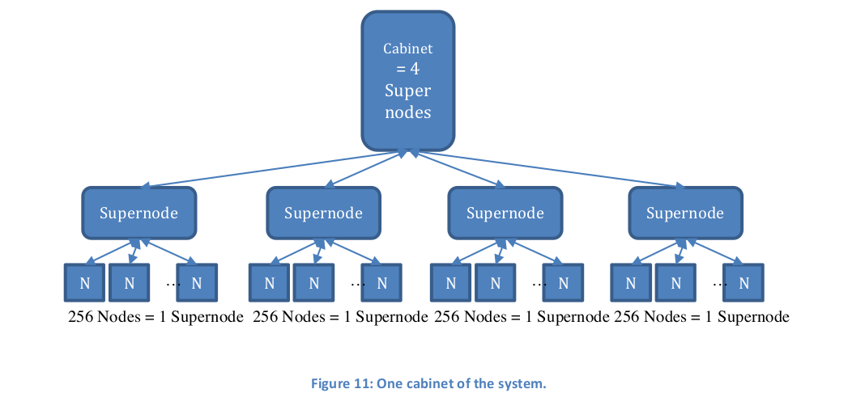
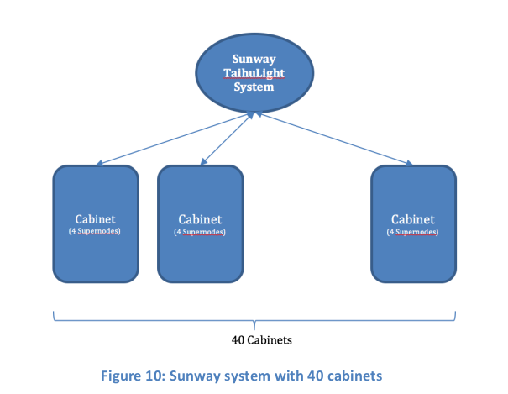
On the Sunway Taihu Light
Kmer matching between DNA sequences is Embarrasingly Parallel (a problem easily seperated into segments)
Image from the Sunway TaihuLight Users Introduction

Slide 13
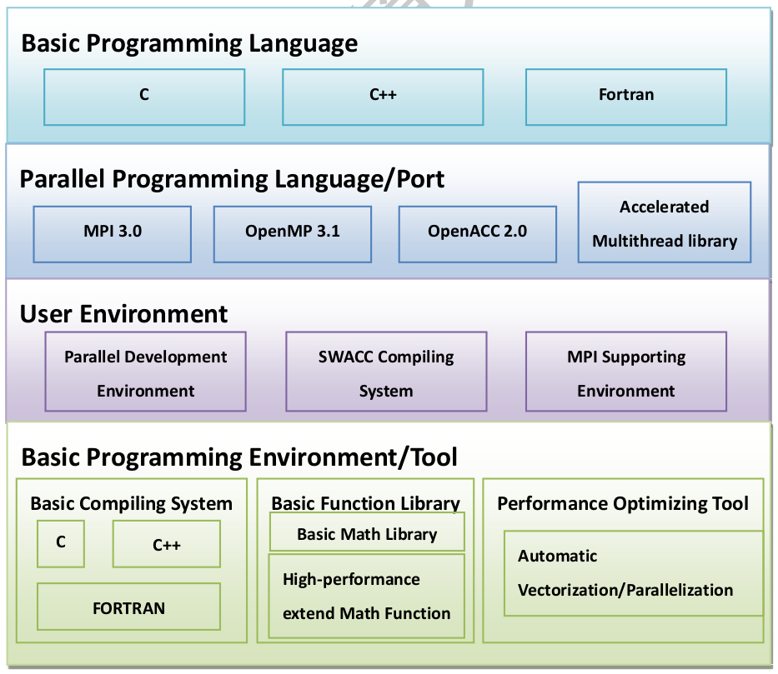
The Right Tools for the Job:
C language
MPI (Message Passing Interface)
Image from the Sunway TaihuLight Users Introduction

Slide 14
Results and Status
Single processor proof-of-concept complete
Multiprocessing version almost complete, outputting kmer match locations
Identifies closest matching sequence per region of MSA

Slide 15
Moving Forward
Create compressed consensus sequence of all identical regions of the MSA
Only search identical regions once for read/kmer matches
May allow for single string compression and search algorithms:
Burrows-Wheeler Transform
Suffix array
Any sorted search method
MSA
Variable region
Variable region
Identical region

Slide 16
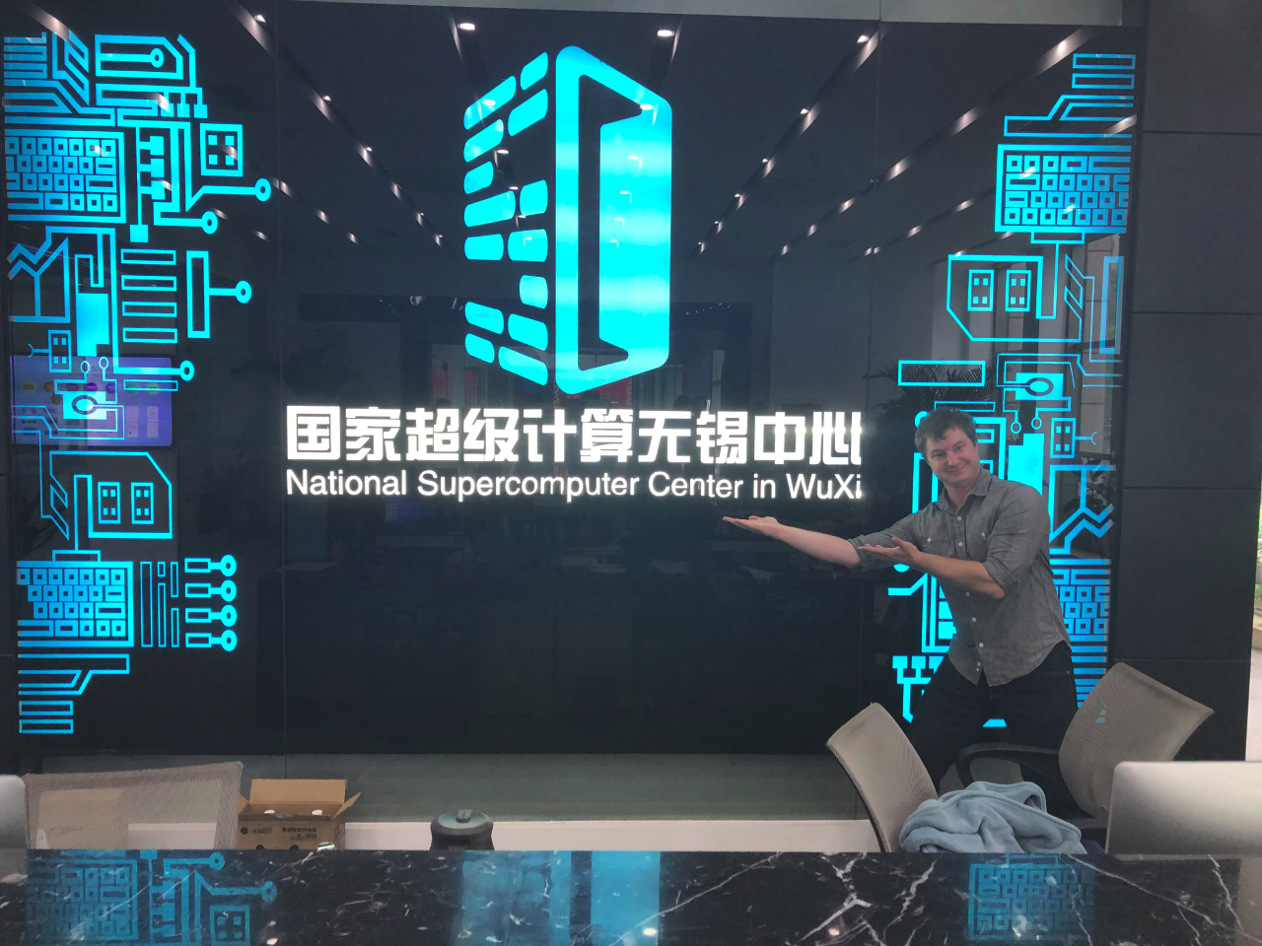
Acknowledgements
Thanks to:
Michigan State University
National Supercomputer Center in Wuxi
IRES: ASSURE
Funded by the National Science Foundation grant No. 1827093

